Slide 1

Data-Driven Prediction of
30-Day Readmissions in Patients
with End-Stage Renal Disease
Using Linked CMS ESRD Records
• Mohammed Faizan Khan • Sakshi Patil • Shashank Yadav • Chetan Panchal 25214501 24304166 25118692 24244058
x25214501@student.ncirl.ie x24304166@student.ncirl.ie x25118692@student.ncirl.ie x24244058@student.ncirl.ie
Notes:
Welcome, everyone. Today we're presenting our group project on predicting 30-day hospital readmission risk in End-Stage Renal Disease kidney patients. This is a high-stakes clinical problem — nearly 1 in 5 kidney patients is readmitted within 30 days of discharge, which is both costly and often preventable. We built a full machine learning pipeline on publicly available CMS administrative data covering over 3 million discharge events. Our team of four will walk you through the problem, our approach, our findings, and why it matters — each of us taking roughly one minute.

Slide 2
State of the Art & Problem Statement
State of the Art
The Problem
▸ ML improves readmission in kidney
▸ 30-day readmission = key quality & cost metric
▸ Kidney ML targets Kt/V & complications not readmission
▸ Frequent care transitions make ESRD patients vulnerable
▸ No study uses all four linked CMS ESRD tables
▸ No data-driven triage tool exists for discharge risk
▸ Data leakage is a recurring flaw in prior pipelines
▸ Linked ESRD administrative data is vastly underused
3.1M
18.28%
100K
Discharge Events Analyzed
30-Day Readmission Rate
Patients in Test Sample
Research Question
Can ML predict 30-day readmission risk in ESRD kidney patients using linked CMS administrative records?
Notes:
Machine learning has improved readmission prediction in kidney failure, but the ESRD dialysis population is fundamentally different — complex treatment regimens, frequent care transitions, and multi-facility data. Existing dialysis-specific ML studies focus on adequacy metrics or complications, not readmission. Critically, many also suffer from data leakage. Our research question was clear: can we use all four linked CMS ESRD tables to build a reliable, leakage-free readmission risk model? That gap in the literature is what we set out to fill.

Slide 3
Project Objective
01
02
Integrate Four Data Sources
Engineer Temporal Features
Link CMS ESRD tables — demographics, treatment, hospitalizations, dialysis adequacy — into one patient-level model.
Encode cumulative hospitalisations, 30/180-day events, discharge gaps, Kt/V trends and treatment modality.
03
04
Compare Three ML Models
Interpret with SHAP
Logistic Regression (baseline), CatBoost, and LightGBM — with leakage-free patient-level train/test split.
Surface clinically meaningful risk drivers to support real discharge-planning decisions.
Notes:
Our project had four clear objectives. First, build a database-first pipeline integrating all four CMS ESRD tables — something no prior study had done in a single coherent workflow. Second, focus on temporal feature engineering: 30-day and 180-day hospitalization counts, discharge gap days, and dialysis adequacy trends. Third, run a head-to-head model comparison under strict patient-level splitting to prevent leakage. Fourth, go beyond accuracy — use SHAP to explain what actually drives each prediction. That last step is critical for clinical adoption.

Slide 4
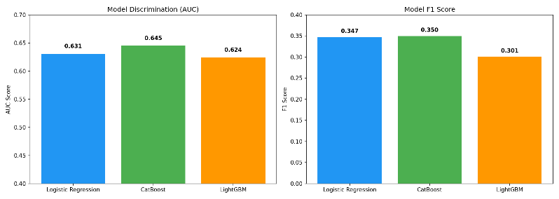
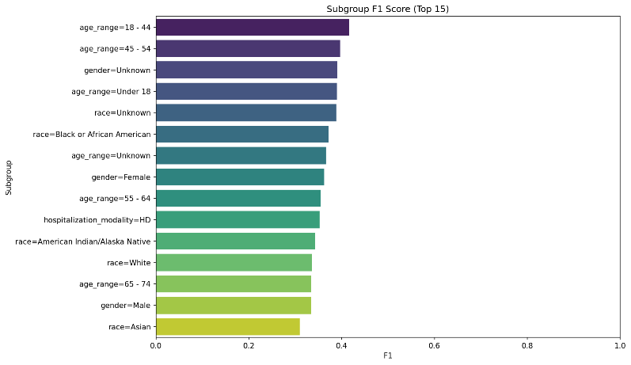
Models & Results
Model Comparison
Model
AUC
F1
Logistic Reg.
0.6309
0.3469
LightGBM
0.6242
0.3499
CatBoost ✓
0.6453
0.3499
0.65
+27pt
+32pt
Best AUC
(CatBoost)
AUC gain
vs baseline
F1 gain
vs baseline
Consistent across all demographic subgroups
Modest variation → broad clinical utility
Notes:
We evaluated all three models on 100,000 unique patients covering ~390,000 hospitalization events. Logistic Regression scored 80% accuracy but near-zero recall — it essentially predicted 'no readmission' for almost everyone. Both CatBoost and LightGBM dramatically outperformed it, reaching AUC of 0.65 and F1 of 0.36. CatBoost edged out as the winner — gaining 27 points in AUC and 32 points in F1 over the logistic baseline. The subgroup chart shows performance is consistent across age groups and racial demographics — an encouraging equity signal. We want to be transparent: AUC 0.65 is moderate. The model is useful for risk ranking and triage — not autonomous clinical decisions.

Slide 5
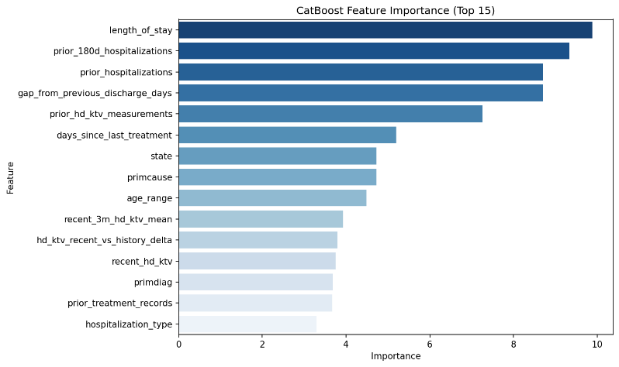
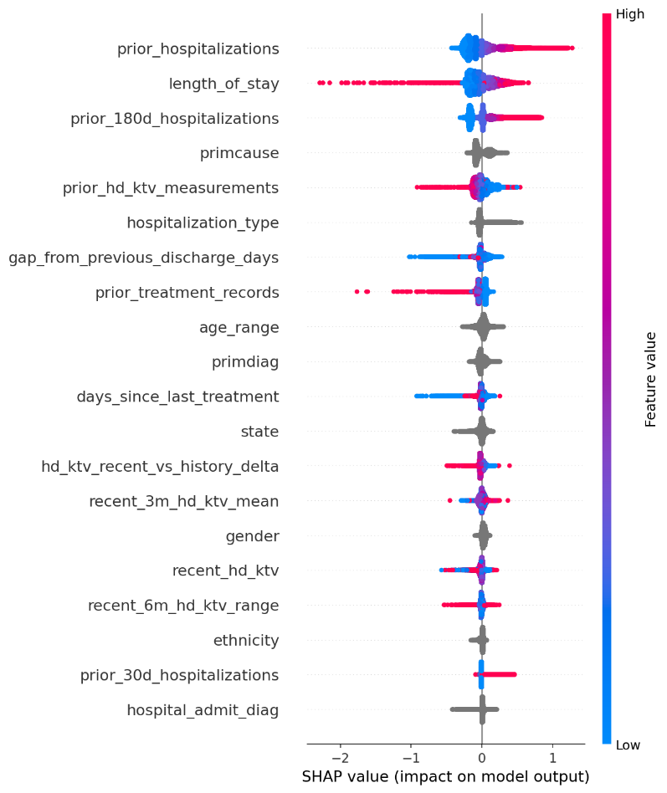
What Drives Readmission Risk? Feature Importance & SHAP
#1
Prior Hospitalizations
Total lifetime burden
#2
Recent 180-day Admissions
Near-term instability
#3
Length of Stay
Illness severity proxy
#4
Discharge Gap (days)
Short gap = higher risk
Notes:
SHAP — SHapley Additive exPlanations — lets us look inside the CatBoost model and understand exactly which features push predictions toward or away from readmission. The left chart shows global feature importance: length of stay, recent 180-day hospitalizations, and prior hospitalizations dominate. The SHAP beeswarm on the right shows direction: patients with high prior hospitalizations — shown in red on the right — strongly increase readmission risk. Dialysis adequacy measures like Kt/V do contribute, but they're secondary to utilization history. This makes clinical sense: a patient who's been in and out of hospital frequently carries a very different risk profile. These findings give clinicians actionable signals to prioritize follow-up at discharge.

Slide 6
Recommendations & Contributions
01
02
Triage Aid — Not Autonomous Diagnosis
Intensify Follow-Up for Repeat Admissions
AUC 0.6453 supports risk stratification.
Work alongside clinicians, not instead of them.
SHAP shows recent hospitalisations drive risk.
Target these patients at every discharge.
03
04
Enrich the Feature Set
Explore Real-Time Deployment
Add medication adherence, socioeconomic
indicators and caregiver support data.
Prospective discharge scoring enables
score-based response tiers in care management.
Notes:
Based on our findings, four concrete recommendations. 01 — Deploy as a triage aid alongside clinicians, not as an autonomous system. AUC 0.65 is good enough to rank patients by risk, not to replace clinical judgment. 02 — Care coordination teams should intensify follow-up for patients with recent repeat hospitalizations — this is where SHAP shows the largest risk concentration. 03 — The next pipeline version should enrich features with medication adherence, social determinants of health, and caregiver data — gaps the CMS administrative files can't fill. 04 — Real deployment would integrate prospective scoring at the point of discharge, triggering different response tiers based on the patient's risk score.

Slide 7
Conclusion
What We Did
Leakage-free ML pipeline on four linked CMS ESRD tables → 3M patients, real hospitalization labels.
What We Found
CatBoost: AUC 0.6453, F1 0.3499 — substantially above baseline. Prior hospitalizations & length of stay dominate risk.
Why It Matters
Moderate discrimination is valuable for clinical triage. Administrative ESRD data holds real predictive signal.
Next steps: Richer features · Subgroup calibration · Prospective real-world deployment
Notes:
To wrap up — three clear takeaways. What we did: Built the first database-first ML pipeline linking all four CMS ESRD tables — leakage-free, on 3 million discharge events, with real hospitalization labels. What we found: CatBoost meaningfully outperforms the logistic baseline. Prior hospitalization burden is the dominant risk signal — something clinicians can directly act on at discharge. Why it matters: Even moderate discrimination is clinically valuable. A score that reliably ranks patients by risk helps discharge planners focus limited follow-up resources where they're needed most. Next steps are clear: richer features, subgroup fairness calibration, and eventually real-time deployment at the point of discharge. Thank you — we're happy to take any questions.

